Slide 1
Feature engineering for healthcare fraud
Chris Kuo, Ph.D.| Columbia University

Slide 2
Most physicians work ethically, but…
The U.S. department of health and human services in a phemphlet Avoiding Medicare Fraud and Abuse: A Roadmap for Physicians states "most physicians strive to work ethically, render high-quality medical care to their patients, and submit proper claims for payment," yet "the presence of some dishonest health care providers who exploit the health care system for illegal personal gain has created the need for laws that combat fraud and abuse and ensure appropriate quality medical care."

Slide 3
Fraud, Waste, Abuse (FWA)
Fraud
is knowingly and willfully executing to defraud any health care benefit program or to obtain any of the money or property owned by any health care benefit program. (18 U.S.C. § 1347)
Waste
is overutilization of services or other practices that result in unnecessary costs to the health care system. It is not generally considered to be caused by criminally negligent actions, but by the misuse of resources.
Fraud
Waste
Abuse
payments for items or services when there is no legal entitlement to that payment and the individual or entity has not knowingly and/or intentionally misrepresented facts to obtain payment.
Abuse

Slide 4

Medicare/Medicaid & private health insurance system
Medicare is a federal program that provides health coverage if you are 65 and older or have a severe disability, regardless of your income.
Medicaid is a state and federal program that provides health coverage if you qualify for a low income.
Or you can get health coverage through any of the private health insurers
The total U.S. health care spending is
18% of GDP, or
$3.3 trillion or
$10,348 per person.
$3.3 trillion * 10%
= $300 billion

Slide 5
Understand the health coding system
Diagnosis
X-ray
Ultrasound
MRI
Treatment
Physical therapy
Surgery
Injections

Slide 6
ICD-10: the International Statistical Classification of Diseases - the 10th revision
(The cause)
S42.321A
Displaced transverse fracture of shaft of humerus, right arm, initial encounter for closed fracture

Slide 7
CPT: The Current Procedural Terminology code
The 5-digit CPT numbers provide the most widely accepted medical nomenclature used to report medical procedures and services for processing claims, conducting research, evaluating healthcare utilization, and developing medical guidelines
There are about 8,800 codes

Slide 8
CPT: The Current Procedural Terminology code
Top 10 CPTs for physical therapy

Slide 9
NDC: the National Drug Code
NDC is a 10-digit product identifier used in the United States for drugs intended for human use. The Drug Listing Act of 1972 requires registered drug establishments to provide the Food and Drug Administration (FDA) with a current list of all drugs manufactured, prepared, propagated, compounded, or processed by it for commercial distribution.

Slide 10
GPI: the Generic Product Identifier
GPI is a 14-character hierarchical drug classification system

Slide 11
Upcoding, unbundling
Upcoding: to “upcode” a regular diagnosis or procedure to a more serious diagnosis or procedure. Since payment is many times based upon the various degrees of diagnosis and procedures, there is an incentive to increase profits by “upcoding” procedures and diagnosis.
Upcoding example: acute bronchitis (J20.9) is reported as Simple chronic bronchitis (J41)
Diagnosis
Treatment
Drug
"Unbundling: Instead of billing for one procedure, the medical coder will “unbundle” the one procedure into multiple procedures. For example, a rotator cuff shoulder surgery is one procedure; however, that one procedure involves several separate individual procedures. A medical billing service or provider may attempt to separate the individual sub-procedures to maximize profits contrary to Medicare guidelines.

Slide 12
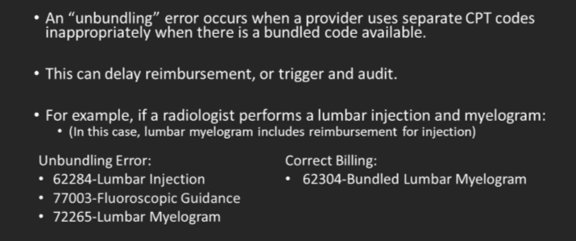
Unbundling

Slide 13
Common medical billing errors

Slide 14
Upcoding examples

Slide 15


Level 1: One patient, one physician, multiple claims
Potential issue | Fraud detection strategy
Unbundling | Multiple services from the same provider across claims that should have been grouped.
Excessive/unnecessary services | Could be discovered when symptoms do not match diagnoses.

Slide 16
Level 2: Multiple providers, multiple claims, one patient
Potential issue | Fraud detection strategy
Unbundling | Multiple services from the same provider across claims that should have been grouped.
Excessive/unnecessary services | Could be discovered when symptoms do not match diagnoses.

Slide 17
Level 3: One provider, multiple claims, multiple patients
Potential issue | Fraud detection strategy
Phantom billing | Distribution among the patients
Excessive/unnecessary services | Could be discovered when symptoms do not match diagnoses.

Slide 18
Level 4: Multiple providers, multiple claims, multiple policies
Potential issue | Fraud detection strategy
Unbundling Phantom billing Excessive/unnecessary services Upcoding | Average cost per diagnosis, or drug # of charges per diagnosis, or drug # of visits in a week

Slide 19
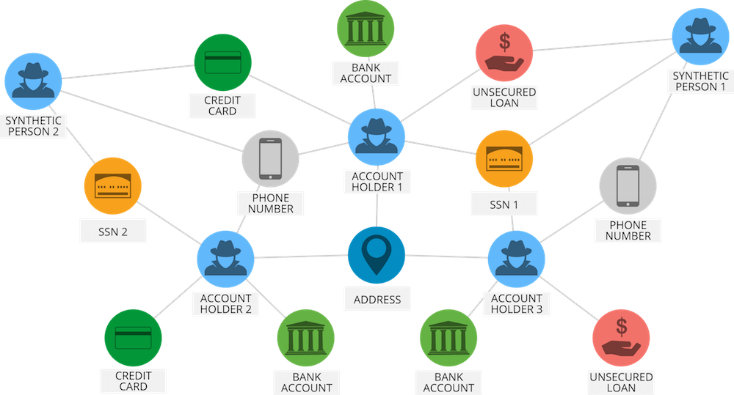
Level 5: Multiple parties, criminal conspiracies
Use graph database (such as Neo4j) to detect the fraud ring

Slide 20
Improving Fraud and Abuse Detection in General Physician Claims
Joudaki et al. (2015).
Features per physician
Standardization using Z scores
Hierarchical clustering
Determine clusters until satisfactory

Slide 21
Features for Abuse & Waste
Cluster 1 – 46%
(75 Physicians)
Cluster 2 – 54%
(89 Physicians)
Indicator | Mean | SD | Mean | SD
% of the patients that they were visited more than once in a month | 16.2 | 5.5 | 21.7 | 11.2
The average of the prescript drug items in a claim | 3.5 | 0.6 | 4.7 | 0.6
The average cost of a drug prescription claim | 23,827 | 5,398 | 29,668 | 5,662
The ratio of the 5 expensive antibiotic prescription to all claims | 0.3 | 0.1 | 0.4 | 0.2
The ratio of injection prescription to all physician claim | 0.8 | 0.3 | 1.5 | 0.4
The ratio of total injection prescription to all physician claim | 1.6 | 0.7 | 2.9 | 0.8
The ratio of total prescript antibiotic to all physician claims | 0.7 | 0.2 | 1.1 | 0.2
The ratio of injected antibiotic to physician claim | 0.2 | 0.1 | 0.4 | 0.2
The ratio of injected corticosteroid prescription to all claim | 0.3 | 0.1 | 0.5 | 0.2

Slide 22
Features for Fraud Detection
Cluster 1 – 98%
(160 Physicians)
Cluster 2 – 2%
(4 Physicians)
Fraud detection | Mean | SD | Mean | SD
% of reduplicative patients | 30.0 | 10.6 | 41.9 | 15.2
% of reduplicative patients-pharmacy | 22.9 | 10.4 | 37.6 | 18.3
% of reduplicative patients-pharmacy in a month | 5.7 | 3.2 | 10.1 | 4.9
The average cost of a drug prescription claim | 26,656 | 5,902 | 40,613 | 4,756
The ratio of claims referred to a high-cost pharmacy | 0.1 | 0.2 | 4.2 | 1.2

Slide 23
Diagnosis-Related Group (DRG)
A Diagnosis-Related Group (DRG) is a statistical system of classifying any inpatient stay into groups for the purposes of payment.
The DRG classification system divides possible diagnoses into more than 20 major body systems and subdivides them into almost 500 groups for Medicare reimbursement.
Factors used to determine the DRG payment amount include the diagnosis involved as well as the hospital resources necessary to treat the condition. Also used by a few states for all payers and by many private health plans (usually non-HMO) for contracting purpose.
Hospitals are paid a fixed rate for inpatient services corresponding to the DRG group assigned to a given patient. Gillian I. Russell, Terminology, in FUNDAMENTALS OF HEALTH LAW 1, 12 (American Health Lawyers Association 5th ed., 2011).
MS-DRG and ICD to MS-DRG

Slide 24
Work cited
Sparrow, M. K. (2000). License to steal: How fraud bleeds America's health care system. Boulder, Colo: Westview Press.
Sparrow M. K. Health care fraud control:understanding the challenge. Journal of insurance medicine- New York- 1996;28:86–96.
Joudaki, H., Rashidian, A., Minaei-Bidgoli, B., Mahmoodi, M., Geraili, B., Nasiri, M., & Arab, M. (2016). Improving Fraud and Abuse Detection in General Physician Claims: A Data Mining Study. International Journal of Health Policy and Management, 5(3), 165–172. http://doi.org/10.15171/ijhpm.2015.196
Aral KDGuvenir HASabuncuoglu Iet al. A prescription fraud detection model. Comput Methods Programs Biomed 2012;106:37–46.
Thornton, D., Mueller, R. M., Schoutsen, P., van Hillegersberg, J.Predicting healthcare fraud in Medicaid: a multidimensional data model and analysis techniques for fraud detection. Procedia Technology
Data

